Slide 1
CSE-311/ CSE-312 Artificial intelligence

Slide 2
Slide 18: Clustering

Slide 3
CLUSTERING
Why do we need to do clustering?
To gain insight into useful underlying patterns (structures) present in data e.g., finance, marketing, transport, etc.
To reduce the data volume while keeping useful information, e.g., information retrieval, image compression and understanding, etc.

Slide 4
CLUSTERING
Definition: Clustering is the task of grouping a set of objects in such a way that objects in the same group (so-called a cluster) are more similar (in some sense) to each other than to those in other groups(clusters).

Slide 5
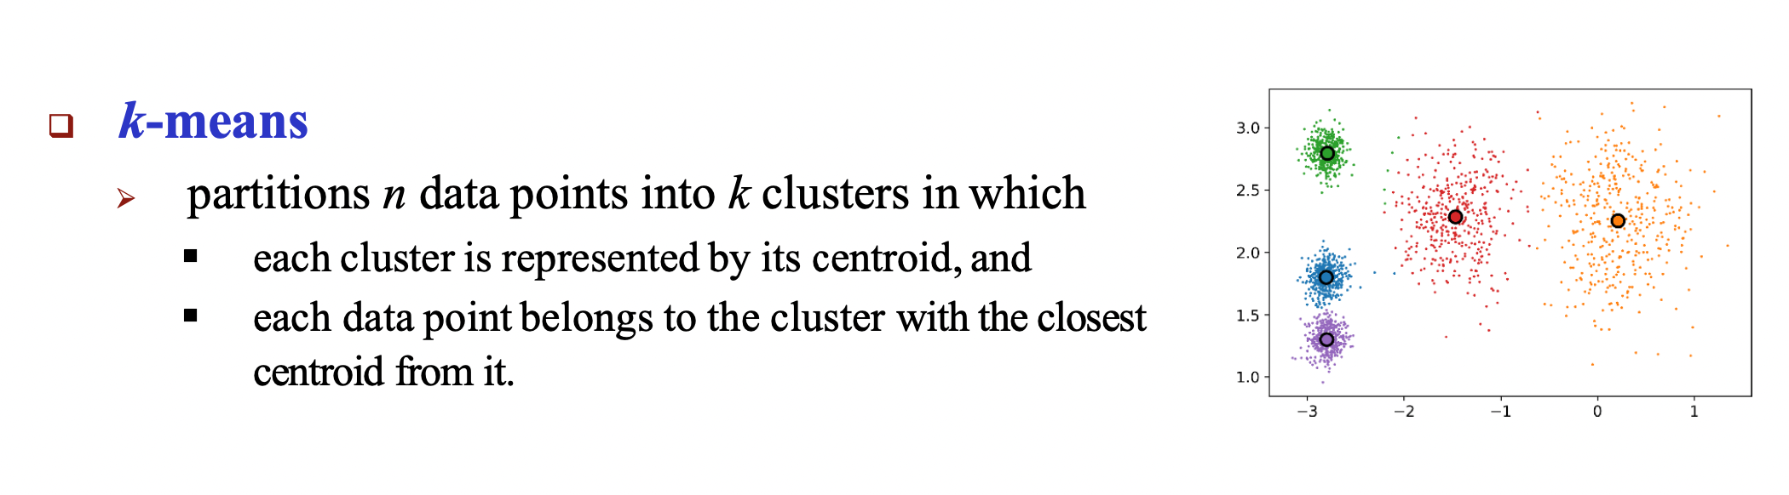
CLUSTERING using K-Means

Slide 6
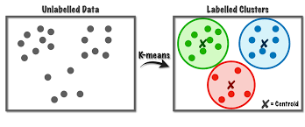

Slide 7
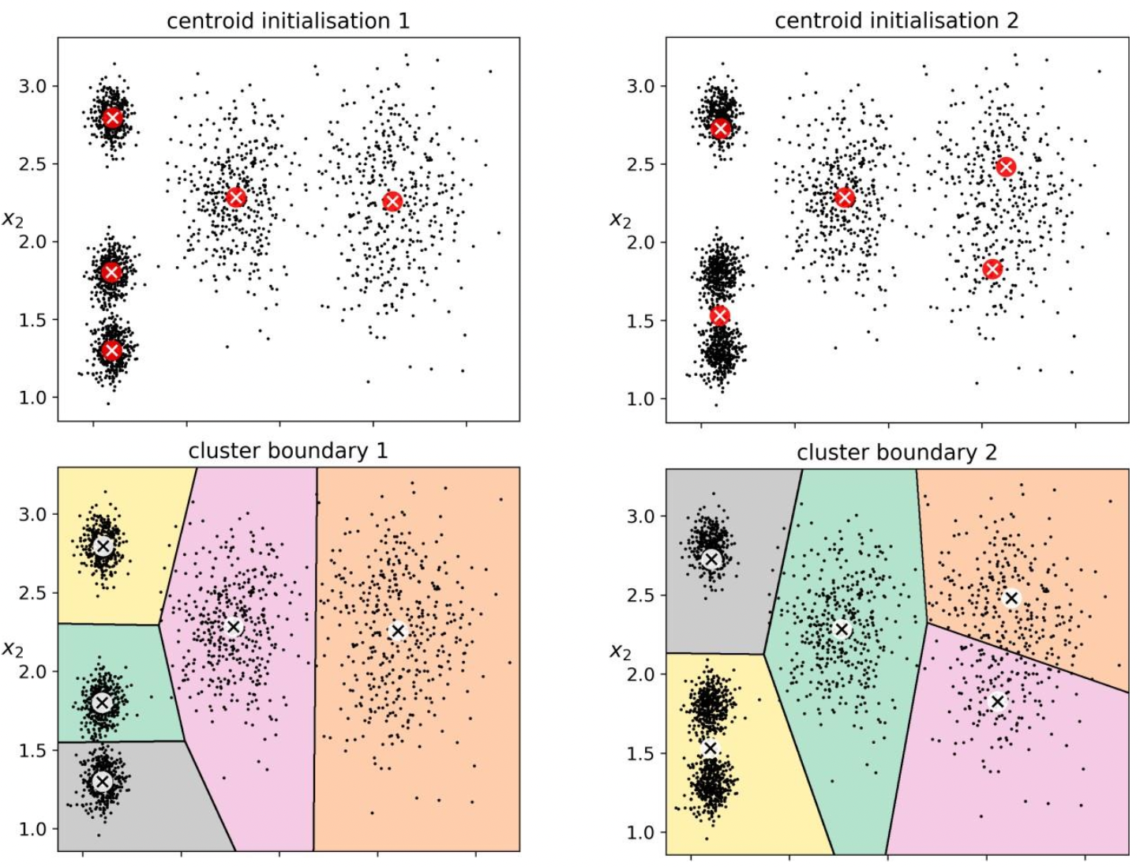
The k-means clustering algorithm may produce different results under different settings of initial centroid positions.

Slide 8
Performance Evaluation of K-Means
We may calculate silhouette coefficient (cluster validity measure) for each of the clustering results obtained under the varying values of k, and draw a curve to find the most suitable value of k.
Silhouette coefficient measures the quality of the clustering result in terms of both cohesion and separation.
Cohesion measures how data points in the same cluster are close to each other.
Separation measures how well data points from different clusters are separated.

Slide 9
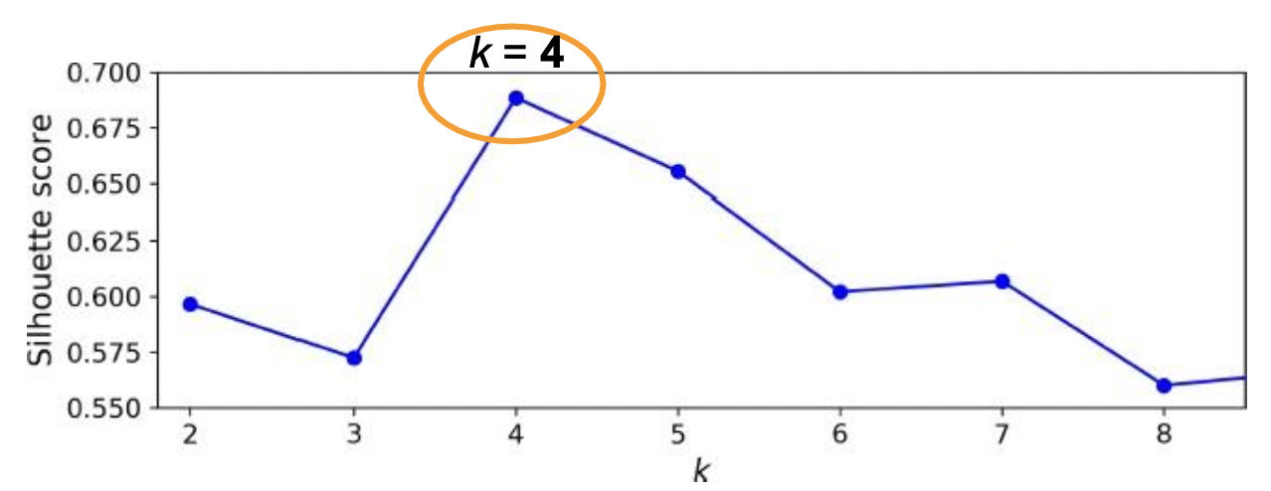
Performance Evaluation of K-Means
from sklearn.metrics import silhouette_score silhouette_score(X, km_trained.labels_)

Slide 10
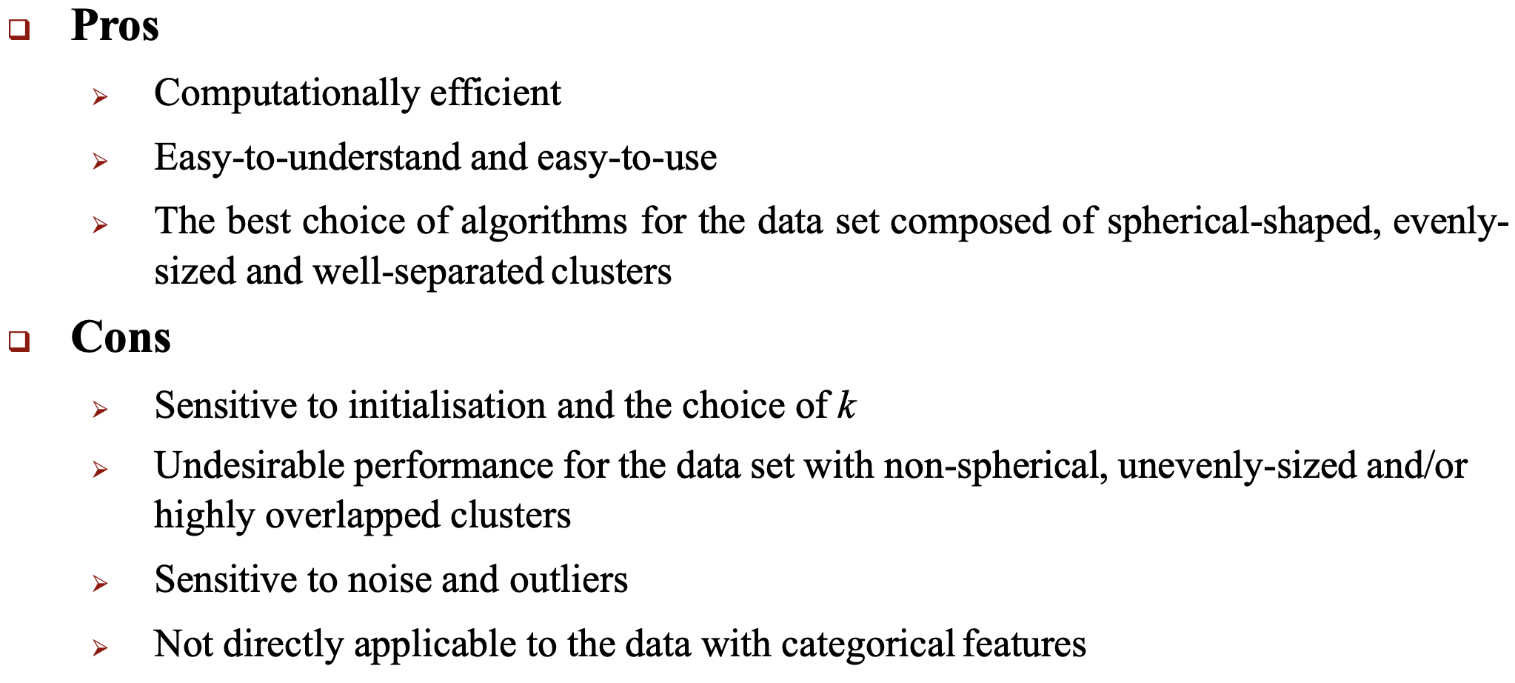

Slide 11
Question and Answers
Define clustering.
What measurement technique do we use to evaluate the performance of clustering models?
What are some pros and cons of using the K-Means method?

Slide 12
End of Slides

